Slide 1


Slide 2


Slide 3
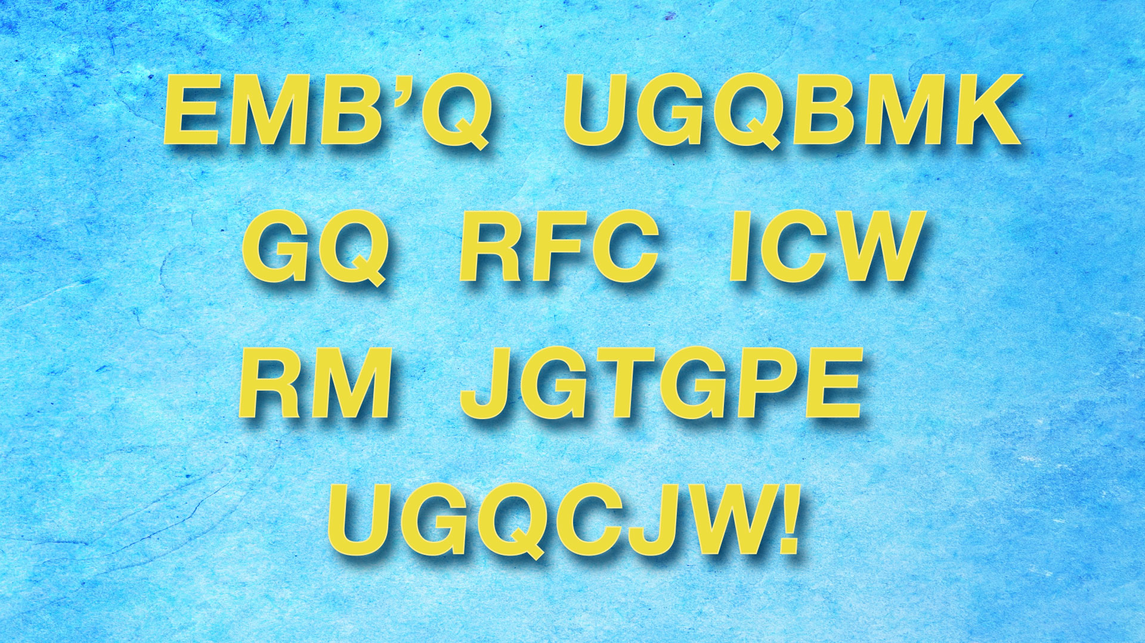

Slide 4


Slide 5


Slide 6


Slide 8
The PowerPoint slides for the Younger Adaptation are found below.
If you are choosing to use the Younger Adaptation portion of the lesson, be sure to modify the PowerPoint to include the Younger Adaptation visuals.

Slide 9
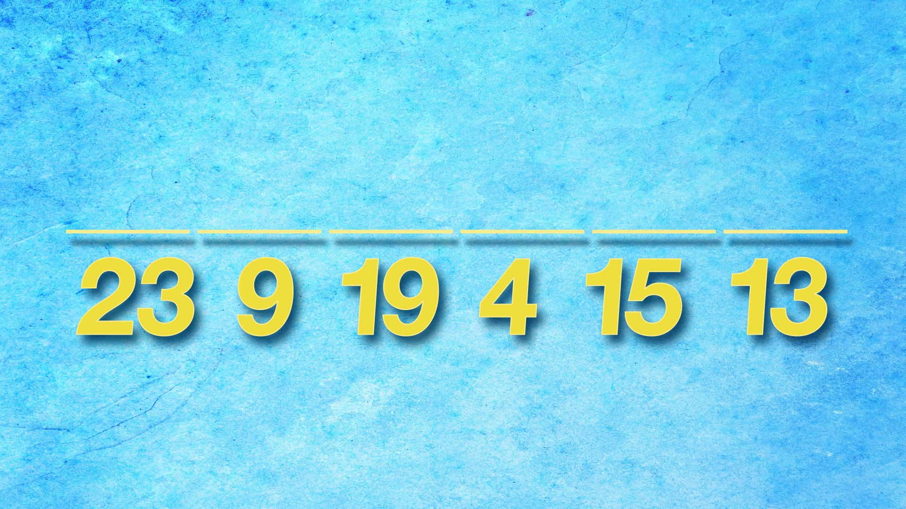

Slide 11
The additional slides below are
provided so the PowerPoint can be adapted to best fit your needs.

Slide 12


Slide 13


Slide 14


